Slide 1



ANALYSIS Of CRIMEs AGAINST WOMEN IN INDIA
SUBMITTED BY-
UDIT NARAYAN SAHOO
BISWAJIT MANDAL
Under the supervision of –
mr. Prasenjit banerjee

Slide 2

INTRODUCTION
Violence against women, defined by the United Nations as any gender-based act resulting in, or likely to result in, physical, sexual, or mental harm, constitutes a severe violation of human rights. It affects women of all ages, castes, and creeds, presenting a widespread public health concern. The repercussions of such violence extend across short-, medium-, and long-term horizons impacting both physical and mental well-being. Beyond individual suffering, the societal and economic ramifications are profound. This issue is entrenched in social, economic, developmental, legal, educational, human rights, and health contexts, contributing to morbidity and mortality among women. The International Day for the Elimination of Violence Against Women, observed on November 25th annually, highlights the persistent challenge. Despite efforts, violence against women impedes progress toward equality, development, peace, and the realization of women’s and girls’ human rights.

Slide 3
OBJECTIVE
Comparing the crimes against women mentioned previously and the overall crime of the country for 5 years, from 2017 to 2021 i.e.; whether each crimes against Women have increased or decreased.
Graphical observation total number of crimes and a state-wise comparison of Crimes against Women in India in 2021.
Analysis of effects of different social variables on the total number of crimes per lakh population by regression analysis.
Forecasting of crimes for future time points, if it is possible.

Slide 4
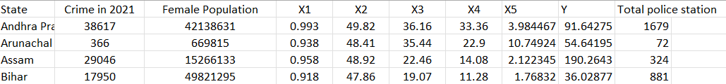
DATA DESCRIPTION
We have collected data on Crime against Women in India of different States from 2017 to 2021 including police station and the data of census of 2011.
• Y= total number of registered crimes against women per lakh female population
• X1= Percentage of female population
• X2= Female literacy rate
• X3= Work force participation rate of female
• X4= Number of police stations per lakh female population
• X5= Urbanization rate workforce

Slide 5
METHODOLOGY
1. To analyze the incidence of each crime graphically, a line diagram is used. In the line diagrams the total number of crimes is plotted against 5 years are 2017 to 2021. The line diagrams are shown for each of the five crimes mentioned previously and also for the total number of crimes against women in India.
2. To do a graphical analysis of the data on crime against women in 2021 the following plots are used
a) Using a pie chart, the proportion of crimes to the total number of crimes for each of the five crimes is shown.
b) Using a Histogram bar diagram, the total number of crimes against women is plotted against the states to get a comparison between the states.
3. To investigate the effect of different social variables on the total number of crimes against women per lakh population, ordinary least squares (OLS) are applied to the cross-sectional data of 2021. Here crime is taken as an error-contaminated variable considering the possibility of underreporting and OLS is applied to an econometric model.
4. Next, different measures and tests are applied to verify the randomness of the data. And is tried to forecast it, if it is possible.

Slide 6
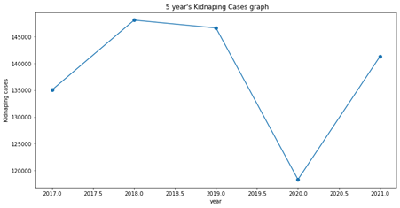
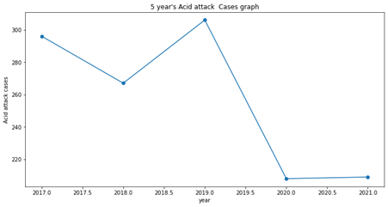
Data visualization
Figure 1: The total number of registered incidents of rape cases has exhibited a continuous increase since the year 2017 to 2018, reaching its peak in 2018 and then slightly decreased in between 2018 to 2019, and decreased in 2020 due to the pandemic effect and then started continuously increasing.
Figure 2: The total number of registered incidents of Kidnapping has exhibited a continuous
increase since the year 2017 to 2018, reaching its peak in 2018 and then slightly decreasing between 2018 to 2019, and completely decreasing in 2020 due to the pandemic effect and then started continuously increasing.

Slide 7
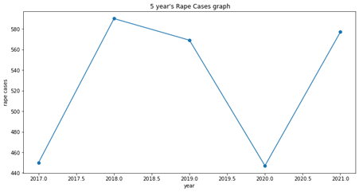
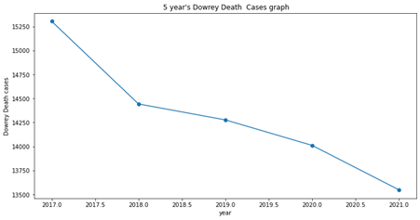
Figure 3: The total number of registered incidents of Dowrey Death has exhibited a sudden downfall since the year 2017 to 2018, and since then it has continuously decreased till 2021.
Figure 4: The total number of registered incidents of Acid Attacks has exhibited a continuous decrease since the year 2017 to 2018, reaching its peak in 2019 then a sudden downfall Between 2019 to 2020 due to the pandemic situation, and since then it has remained the same as 2020.

Slide 8
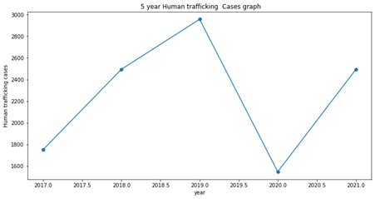
Figure 5: The total number of registered incidents of Human Trafficking has exhibited a continuous increase since the year 2017 to 2019 reaching its peak in 2019 then a sudden downfall in
between 2019 to 2020 due to the pandemic situation, and since then it has continuously increased until 2021.

Slide 9
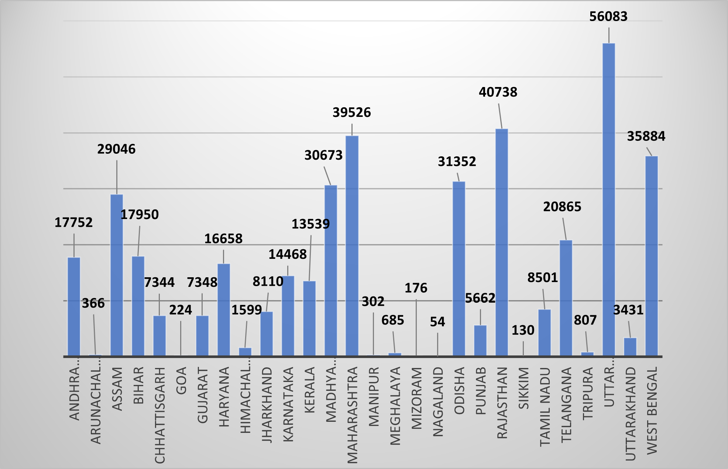
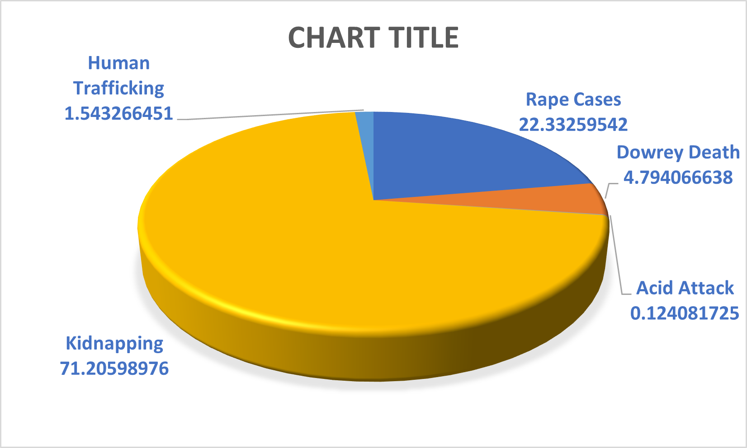
Graphical Representation
Figure 6: In 2021, the highest number of crimes against women occurred in Uttar Pradesh.
Rajasthan got the 2nd position, followed by Maharashtra in the 3rd position. West Bengal got
the 4th position, while Odisha ranked the 5th position in the total number of crimes against
women in 2021.
Figure 7: In 2021, it can be concluded that among the five crimes against women, Kidnapping holds the largest proportion, followed by Rape Cases and then Dowrey Death, Human Trafficking, and Acid Attacks respectively.

Slide 10
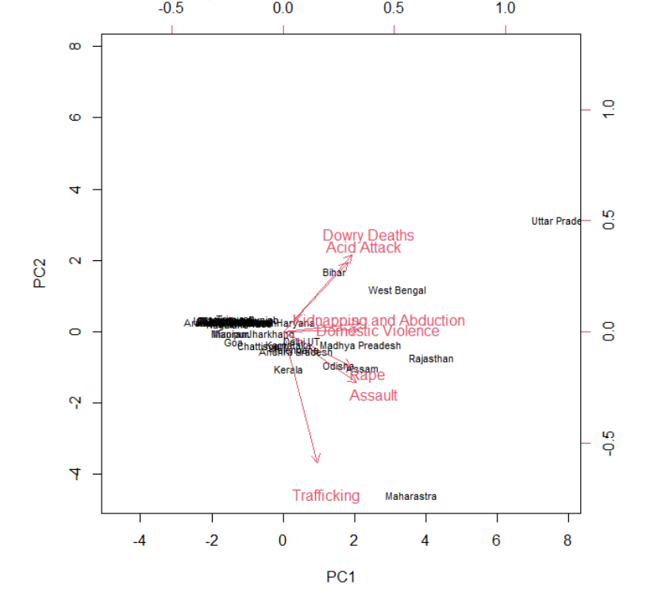
Figure 8: The state names represent the scores for the first two principal components. The pink arrows indicate the first two principal component loading vectors.
• Bihar exhibited a higher susceptibility to crimes such as Acid Attacks and Dowry Deaths.
• West Bengal showed a higher susceptibility to crimes such as Domestic Violence Kidnapping and Abduction.
• Uttar Pradesh demonstrated a higher susceptibility to crimes such as Acid Attacks, Dowry Deaths, and Kidnapping.
• On the other hand, Rajasthan, Madhya Pradesh, Assam, Odisha, and Delhi were more prone to crimes such as Rape cases.
• Maharashtra was prone to Human Trafficking.
• Similarly, states such as Goa, Manipur, Mizoram, Sikkim, Uttarakhand, and Union Territories like Daman and Diu, Lakshadweep, and Puducherry exhibited a lower susceptibility to
any crime and Some states were significantly less prone to any crime, and there may be an overlap in those regions.

Slide 11
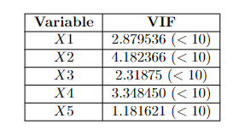
Data Preprocessing
In order to perform regression and time series forecasting we checked for outlier, Missing Values, Normality, Heteroscedasticity and Multicollinearity.
But Missing values and Outliers are not present in the Data.
Normality Check:
In order to check whether the error terms follow normal distribution or not we perform Shapiro Wilk normality test and get the results, Value of test statistic= W = 0.93011, p-value = 0.02818(< 0.93011) Therefore, we fail to reject the null hypothesis at 1% level of significance and conclude that the error term follows a normal distribution
Heteroscedasticity check:
In order to check that whether heteroscedasticity is present in the error term or not we perform Glejser test and get the results, Value of test statistic=8.68 p-value= 0.122(< 8.68) Therefore, we fail to reject the null hypothesis at 1% level of significance and conclude that heteroscedasticity is not present in the data that is the error terms are homoscedastic.
Checking for Multicollinearity :
In order to check the presence of multicollinearity between the independent variables that is between the covariates we use the Variance Inflation Factor(VIF). VIF for each of the 5 variables are less than 10. Therefore, we can conclude that multicollinearity is not present between the independent variables.

Slide 12
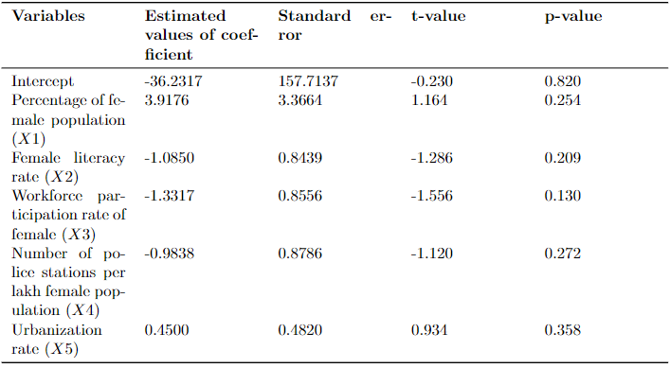
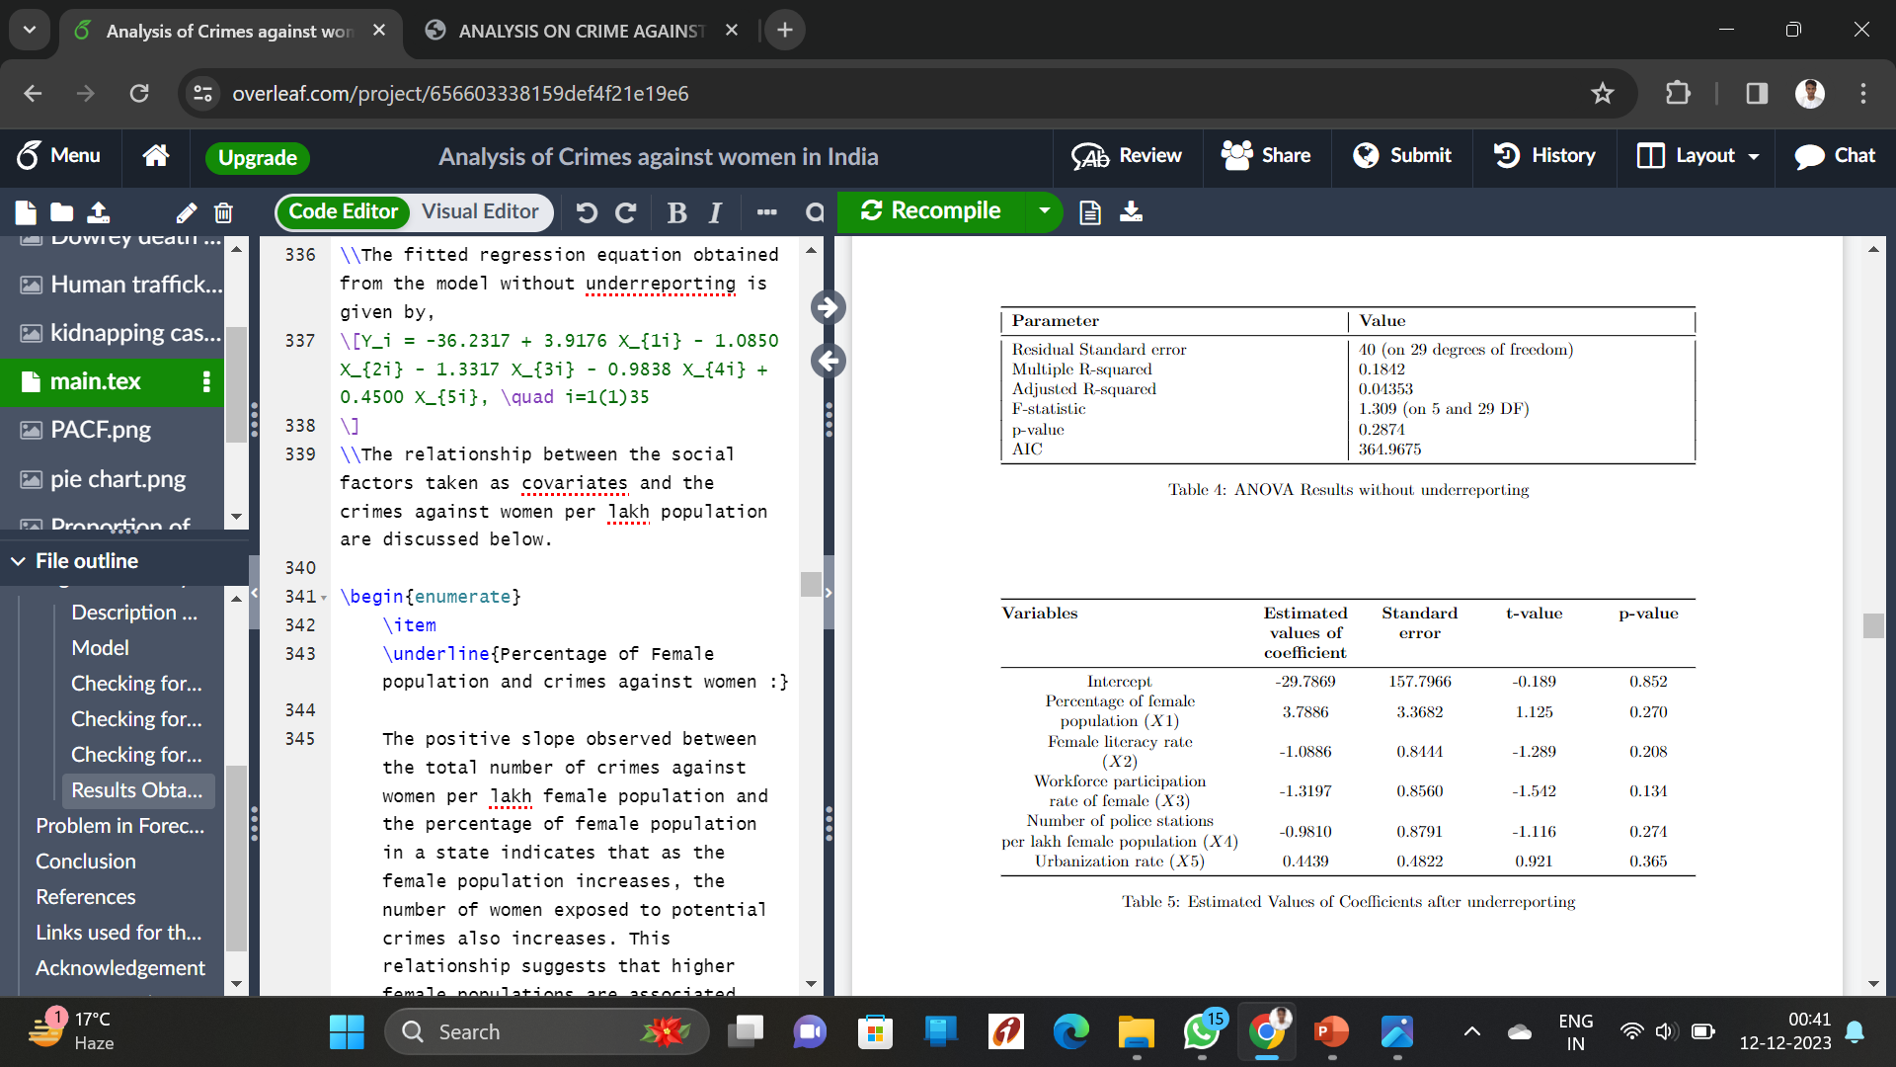
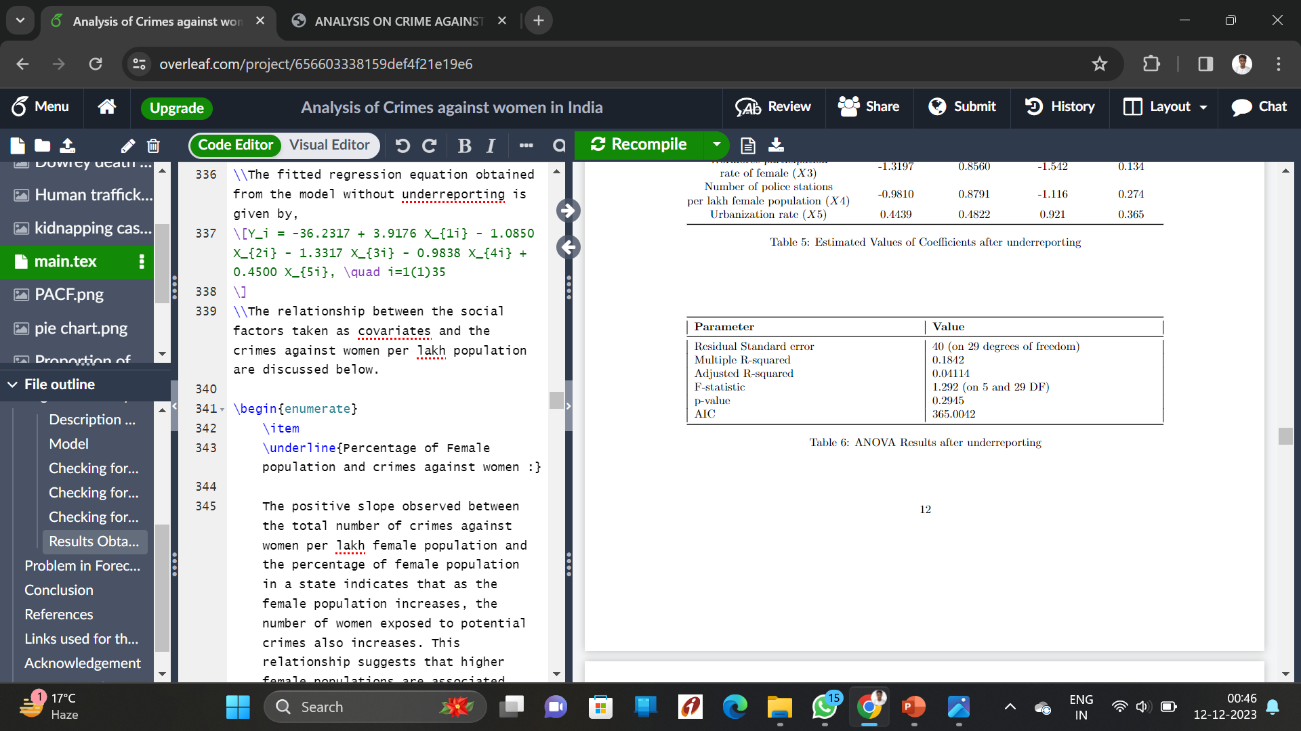
Regression Analysis
From the above results it can be observed that the AIC (Akaike Information Criterion) is less for the model without underreporting. Therefore, the model without underreporting gives the best fit for the data. The fitted regression equation obtained from the model without underreporting is given by,
Y_{i}= -36.2317 + 3.9176 X_{1i} -1.0850 X_{2i} -1.3317 X_{3i} -0.9838 X_{4i} + 0.4500 X_{5i} , i=1(1)35

Slide 13
Percentage of Female population and crimes against women:
The positive slope observed between the total number of crimes against women per lakh female population and the percentage of female population in a state indicates that as the female population increases, the number of women exposed to potential crimes also increases.
Female literacy rate and crime against women :
”Education is the vaccine for violence.” This statement underscores the transformative power of education as a potent tool for women to mitigate the occurrence of violence against them.
Work force participation rate of female and crime against women :
The workforce participation rate of females exhibits a negative impact on crimes against women.
Number of police stations and crime against women :
The number of police stations per lakh female population demonstrates a negative relation-ship with crimes against women.
Urbanization rate and crime against women :
The urbanization rate is positively correlated with crimes against women, indicating that the incidence of such crimes is higher in urban area

Slide 14
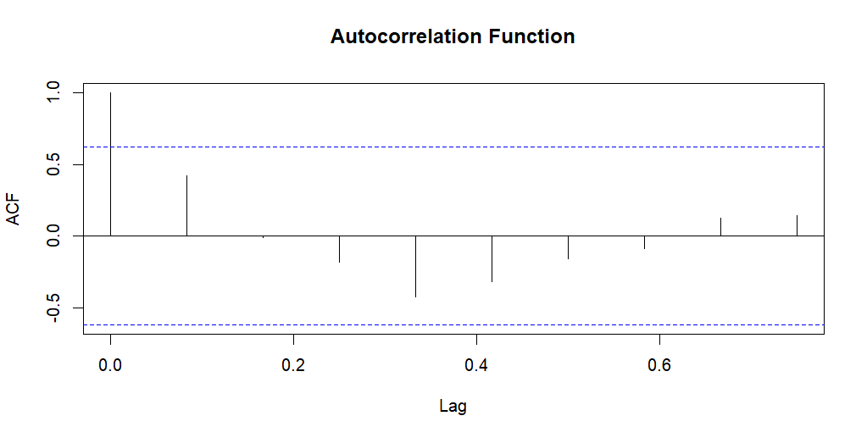
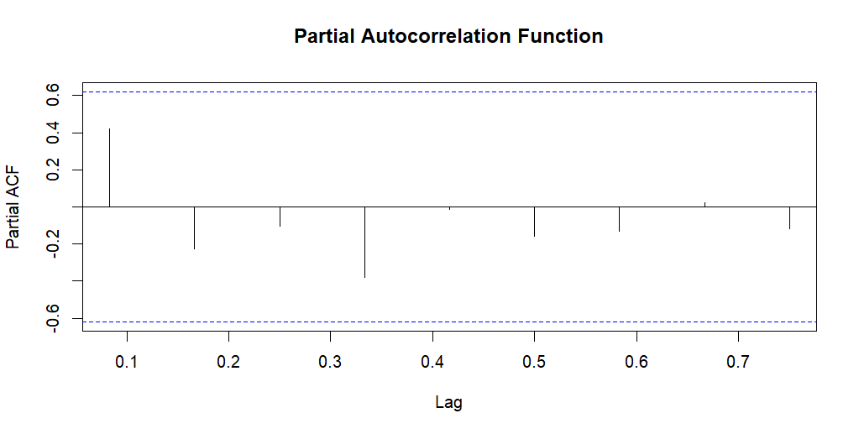
Problem in Forecasting for Future Time
We can conclude that the autocorrelation is 1 only at lag zero. For all other lags, the autocorrelations either fall within the confidence band or are nearly zero. This observation leads us to the conclusion that our data is entirely random in nature.
Observing that the partial autocorrelation for each lag is within the confidence band, we can conclude that our data is entirely random in nature based on this plot.
Therefore, we can not forecast the number of rapes in India for future time point. Similarly, each crime category in India exhibits the same characteristic. Consequently, we cannot forecast any specific crime for any state using our dataset.

Slide 15
Conclusion
Our Objectives
Comparing the crimes against women mentioned previously and the overall crime of the country for 5 years, from 2017 to 2021 i.e.; whether each crime against Women has increased or decreased.
Graphical observation total number of crimes and a state-wise comparison of Crimes against Women in India in 2021.
Analysis of effects of different social variables on the total number of crimes per lakh population by regression analysis.
Forecasting of crimes for future time points, if it is possible.
Findings
As we have seen in the Data Visualization part most of the crimes got the peak in the year 2019 or so and then collapsed due to the pandemic situation and again started growing.
We have seen in the Graphical Representation part that the highest number of crimes against women occurred in Uttar Pradesh and among the five crimes against women, Kidnapping holds the largest proportion.
After completing the Regression Analysis we got the model to look like this-
Y_{i}= -36.2317 + 3.9176 X_{1i} -1.0850 X_{2i} -1.3317 X_{3i} -0.9838 X_{4i}
+ 0.4500 X_{5i} , i=1(1)35
Due to the complete randomness of the data Forecasting is not possible with this Data.

Slide 16
References
• ”Time Series Analysis and Its Applications: With R Examples” by Robert H. Shumway and David S. Stoffer
• ”Introduction to Time Series and Forecasting” by Peter J. Brockwell and Richard A. Davis
• ”Applied Time Series Analysis for the Social Sciences” by John L. T. Cook and Linda C.Skinner
• ”Forecasting: Principles and Practice” by Rob J Hyndman and George Athanasopoulos
• ”Time Series Analysis: Forecasting and Control” by George E. P. Box, Gwilym M. Jenkins, and Gregory C. Reinsel
• ”Practical Regression and Anova using R” by Julian J. Faraway
• ”A Modern Approach to Regression with R” by Simon Sheather
• ”Regression Analysis: Concepts and Applications” by Philip H. Kott
• ”Regression Analysis by Example” by Samprit Chatterjee, Ali S. Hadi, and Bertram Price
• ”Pattern Recognition and Machine Learning” by Christopher M. Bishop
• ”Deep Learning” by Ian Goodfellow, Yoshua Bengio, and Aaron Courville
• ”The Hundred-Page Machine Learning Book” by Andriy Burkov
• ”Understanding Machine Learning: From Theory to Algorithms” by Shai Shalev-Shwartz
and Shai Ben-David
• ”Machine Learning for Dummies” by John Paul Mueller and Luca Massaron
• ”Modeling and Forecasting Crime: A Review” by Jeffery T. Walker
• ”Time Series Analysis for Crime Prevention: Assessing the Impact of Foot Patrol in Violent
Crime Reduction” by Jerry H. Ratcliffe and George E. Tita
• ”Time Series Analysis of Crime Rates” by John R. Hipp and Adam Boessen
• ”Forecasting the Future of Predictive Crime Mapping” by Rachel L. Boba
• ”Short-Term Forecasting of Crime” by Leslie Kennedy, James D. Green, and Lawrence F.
Travis III
• ”Spatio-Temporal Crime Hotspots and the Ambient Population” by Rachel L. Boba and

Slide 17
• NCRB crime data search links for years 2017 to 2021 in India :
For 2017:Click Here
For 2018:Click Here
For 2019:Click Here
For 2020:Click Here
For 2021:Click Here
• Data search link for literacy rate of females of each state in India: Click Here
• Data search link for workforce participation rate of women of each state in India: Click
Here
• Data search link for police stations of each state in India: Click Here
• Data search link for the female population of each state in India: Click Here
• Data search link for the urbanization rate of each state in India: Click Here
• Crime in India: specification and estimation of violent crime index published in Journal of
Productivity Analysis: Click Here
• Analysis of Growth and Identifications of the Determinants of Crime against Women:
Insight from India published in Journal of International Women’s Studies : Click Here

